Slide 1

NOIDA INSTITUTE OF ENGINEERING & TECHNOLOGY GREATER NOIDA
B.Tech 4th Year, VII Sem. Entrepreneurship Development & Intellectual Property Rights (AOE0771)
Unit 2
By
Alok Raj
Assistant Professor
MBA Department
NIET, GREATER NOIDA

Slide 2
Index/Content
S. No. | Index
1. | Name of Subject with code, Course and Subject Teacher
2. | Course Objective(s)
3. | Course Outcome(s)
4. | Program Outcomes (PSOs)
5. | Cos and POs Mapping
6. | Lecture related to topic
7. | Daily Quiz
8. | Weekly Assignment
9. | Topic Links
Subject: Entrepreneurship Development & Intellectual Property Rights By : Alok Raj
Mohd Zaid AOE0771 Unit 2

Slide 3
Index/Content
S. No. | Index
10. | MCQs
11. | Glossary Questions
12. | Recap of unit
Subject: Entrepreneurship Development & Intellectual Property Rights By : Alok Raj
Mohd Zaid AOE0771 Unit 2

Slide 4
Faculty Introduction
Faculty Name: Mr. Alok Raj
Designation : Assistant Professor
Department : MBA
Qualification :
MBA(Marketing and Operations)
Specialization : MBA(Marketing and Operations)
Teaching Area: General Management, Entrepreneurship, Operations Management
.
Subject: Entrepreneurship Development & Intellectual Property Rights By : Alok Raj

Slide 5

Subject Syllabus
Unit –I
Entrepreneurship: need, scope,
Entrepreneurial competencies & traits,
Factors affecting entrepreneurial development,
Entrepreneurial motivation (Mc Clelland Achievement motivation theory), conceptual model of entrepreneurship,
entrepreneur vs. intrapreneur;
Classification of entrepreneurs; Entrepreneurial Development Programmes.
Subject: Entrepreneurship Development & Intellectual Property Rights By : Alok Raj
30-Aug-25 Mohd Zaid AEO0771

Slide 6
Subject Syllabus
Unit –II
Introduction to Innovation,
Entrepreneurial Idea Generation and Identifying Business Opportunities,
Management skills for Entrepreneurs and managing for Value Creation,
Creating and Sustaining Enterprising Model & Organizational Effectiveness,
New initiatives taken by the Government to promote entrepreneurship in India at a larger scale.
Subject: Entrepreneurship Development & Intellectual Property Rights By : Alok Raj
30-Aug-25 Mohd Zaid AEO0771

Slide 7
Subject Syllabus
UNIT III
The business plan as an entrepreneurial tool,
Business Planning Process: elements of business planning, preparation of project plan,
Components of an ideal business plan – market plan, financial plan, operational plan, and,
Feasibility Analysis – aspects and methods: Economic, financial, and market analysis - and technological feasibility. Various Forms of business ownership,
Registration of business units; start-up to going IPO; revival, exit and end to a venture.
Subject: Entrepreneurship Development & Intellectual Property Rights By : Alok Raj
30-Aug-25 Mohd Zaid AEO0771

Slide 8
Subject Syllabus
UNIT IV
Estimating financial funds requirement; Sources of finance – banks and financial institutions – IFCI, ICICI, IDBI and SIDBI), financing of Small Business Unit. Role of central government and state government in promoting entrepreneurship with various incentives, subsidies, grants, export oriented units – fiscal & tax concessions, other government initiatives and inclusive entrepreneurial growth. Overview of MSME policy of government in India. Role of agencies assisting entrepreneurship
Entrepreneurship Development Institute (EDI). DICs, SSIs, NSICs, EDII NIESBUD, NEDB
New initiatives taken by government to promote entrepreneurship in India at larger scale.
Subject: Entrepreneurship Development & Intellectual Property Rights By : Alok Raj
30-Aug-25 Mohd Zaid AEO0771

Slide 9
Subject Syllabus
UNIT V
Introduction to Intellectual Property Right (IPR), intellectual property and its protection, Forms of Protection depending on product; Patent, copyright, trademark, design knowhow, trade secrets etc.
Subject: Entrepreneurship Development & Intellectual Property Rights By : Alok Raj
30-Aug-25 Mohd Zaid AEO0771

Slide 10


Noida Institute of Engineering and Technology, Greater Noida
Entrepreneurial Idea and Innovation
Unit:2
Subject Name
Entrepreneurship Development & IPR
Alok Raj
Department of MBA
Course Details B.Tech (BT) 7th Semester
Subject: Entrepreneurship Development & Intellectual Property Rights By : Alok Raj

Slide 11
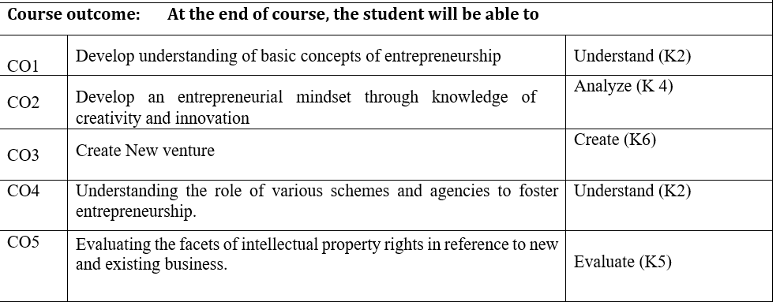
Course Outcome
Subject: Entrepreneurship Development & Intellectual Property Rights By : Alok Raj

Slide 12
Program Educational Outcomes
PEO1: Conceptual Knowledge to adapt in rapidly changing environment and learn new skills and demonstrate application of management principles in professional work setting.
PEO2: Apply appropriate tools for decision making for solving complex managerial problems in local or global context.
PEO3: Exhibit Integrity, social responsibility and teamwork.
PEO4: Exhibit ethics, communication skills, leadership qualities and entrepreneurial mindset.
Subject: Entrepreneurship Development & Intellectual Property Rights By : Alok Raj

Slide 13
Course Objective
Explore the dimensions of creativity, innovation, and entrepreneurship
Understand the various sources of idea generation for startups
Understanding the requirements and methods of launching a new business.
Develop an understanding of various schemes and agencies for assisting and fostering entrepreneurship
Develop an understanding of intellectual property rights.
Subject: Entrepreneurship Development & Intellectual Property Rights By : Alok Raj
30-Aug-25 Mohd Zaid AEO0771

Slide 14
Course Objective
Explore the dimensions of creativity, innovation, and entrepreneurship.
Develop an understanding of intellectual property rights.
Be familiar with the financial support associated with new venture start-ups.
Understand the various sources of idea generation and screening.
Understand the policy framework for promoting entrepreneurship and providing finance to entrepreneurs.
Subject: Entrepreneurship Development & Intellectual Property Rights By : Alok Raj
30-Aug-25 Mohd Zaid AEO0771

Slide 15
Program Outcomes
1. Engineering knowledge: Apply the knowledge of mathematics, science, engineering fundamentals, and an engineering specialization for the solution of complex engineering problems.
2. Problem analysis: Identify, formulate, research literature, and analyse complex engineering problems reaching substantiated conclusions using first principles of mathematics, natural sciences, and engineering sciences.
3. Design/development of solutions: Design solutions for complex engineering problems and design system components or processes that meet the specified needs with appropriate consideration for public health and safety, and cultural, societal, and environmental considerations.
Subject: Entrepreneurship Development & Intellectual Property Rights By : Alok Raj

Slide 16
Program Outcomes
4. Conduct investigations of complex problems: Use research-based knowledge and research methods including design of experiments, analysis and interpretation of data, and synthesis of information to provide valid conclusions.
5. Modern tool usage: Create, select, and apply appropriate techniques, resources, and modern engineering and IT tools, including prediction and modeling to complex engineering activities, with an understanding of the limitations.
6. The engineer and society: Apply reasoning informed by the contextual knowledge to assess societal, health, safety, legal and cultural issues and the consequent responsibilities relevant to the professional engineering practice.
Subject: Entrepreneurship Development & Intellectual Property Rights By : Alok Raj
30-Aug-25 Mohd Zaid AEO0771

Slide 17
Program Outcomes
7. Environment and sustainability: Understand the impact of the professional engineering solutions in societal and environmental contexts, and demonstrate the knowledge of, and need for sustainable development.
8. Ethics: Apply ethical principles and commit to professional ethics and responsibilities and norms of the engineering practice.
9. Individual and teamwork: Function effectively as an individual, and as a member or leader in diverse teams, and in multidisciplinary settings.
Subject: Entrepreneurship Development & Intellectual Property Rights By : Alok Raj
30-Aug-25 Mohd Zaid AEO0771

Slide 18
Program Outcomes
10. Communication: Communicate effectively on complex engineering activities with the engineering community and with the society at large, such as, being able to comprehend and write effective reports and design documentation, make effective presentations, and give and receive clear instructions.
11. Project management and finance: Demonstrate knowledge and understanding of the engineering and management principles and apply these to one’s own work, as a member and leader in a team, to manage projects and in multidisciplinary environments.
12. Life-long learning: Recognize the need for and have the preparation and ability to engage in independent and life-long learning in the broadest context of technological change.
Subject: Entrepreneurship Development & Intellectual Property Rights By : Alok Raj
30-Aug-25 VIJAY LAXMI AEO0771

Slide 19
Program Educational Outcomes
Program Educational Outcomes
PEO1: Conceptual Knowledge to adapt in rapidly changing environment and learn new skills and demonstrate application of management principles in professional work setting.
PEO2: Apply appropriate tools for decision making for solving complex managerial problems in local or global context
PEO3: Exhibit Integrity, social responsibility and teamwork
PEO4: Exhibit ethics, communication skills, leadership qualities and entrepreneurial mindset
Subject: Entrepreneurship Development & Intellectual Property Rights By : Alok Raj
30-Aug-25 VIJAY LAXMI AEO0771

Slide 20
Objective of the unit
To help the students learn:
Means of generating product ideas for a new venture
New product development and process
Subject: Entrepreneurship Development & Intellectual Property Rights By : Alok Raj

Slide 21
Course Outcome
Course outcome | At the end of course, the student will be able to
CO1 | Develop understanding of basic concepts of entrepreneurship. | K1,K2
CO2 | Develop an entrepreneurial mindset through knowledge of creativity and innovation | K3,K4
CO3 | Evaluating and understanding a holistic approach of launching a new business venture | K4
CO4 | Understanding of converting an Idea to an opportunity and various funding sources | K2
CO5 | Develop knowledge on Entrepreneurial Finance, Assistance and role of Entrepreneurial Development Agencies | K4, K5
Subject: Entrepreneurship Development & Intellectual Property Rights By : Alok Raj
30-Aug-25 Mohd Zaid AEO0771

Slide 22
CO-PO and PSO Mapping
Sr. No | Course Outcome | PO1 | PO2 | PO3 | PO4 | PO5
1 | CO 1 | H | H | M
2 | CO 2 | M |  |  | H
3 | CO 3 | H | M |  |  | M
4 | CO 4 | H |  |  |  | H
5 | CO 5 | H |  | H |  | M
Program Specific Outcomes | Course Outcomes
 | 1 | 2 | 3 | 4 | 5
1 | M | H | H | H | H
2 |  | M |  | H
3 | H | M | M | M
4 | H | H |  | M | M
Subject: Entrepreneurship Development & Intellectual Property Rights By : Alok Raj
30-Aug-25 Mohd Zaid AEO0771

Slide 23
ENTREPRENEUR
Idea Generation
Idea Generation and Screening
Methods of Generating Ideas
Linear techniques –
Matrix and Morphological Analysis,
Force Field Analysis, Attribute Listing , Scamper
Alternative Scenarios
Forced Association
Value Analysis
Product Planning and development Process
Environmental Scanning and SWOT analysis.
Management skills for Entrepreneurs and managing for Value Creation, Creating
and Sustaining Enterprising Model & Organizational Effectiveness
Subject: Entrepreneurship Development & Intellectual Property Rights By : Alok Raj
30-Aug-25 Mohd Zaid AEO0771

Slide 24
Means of generating Ideas
1. Focus Groups: Open, in-depth discussion discussions for a new product area that can result in market success.
2. Brainstorming: Keeping criticism away; free wheeling of idea, high quantity of ideas, combinations and improvements of ideas.
3. Problem inventory analysis: The consumers are provided with list of problems and then asked to have discussion over it and it ultimately results in an entirely new product idea.
Subject: Entrepreneurship Development & Intellectual Property Rights By : Alok Raj
30-Aug-25 Mohd Zaid AEO0771

Slide 25
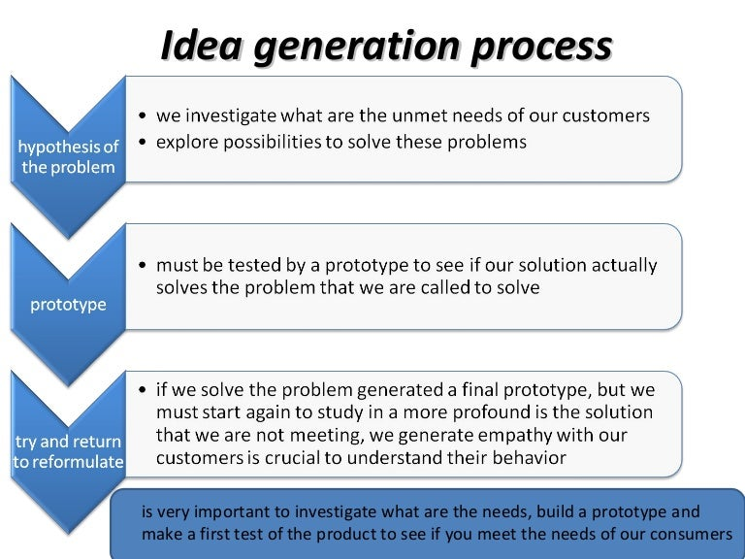
6Cs that motivate entrepreneurs
Means of generating Ideas
Subject: Entrepreneurship Development & Intellectual Property Rights By : Alok Raj
30-Aug-25 Mohd Zaid AEO0771

Slide 26
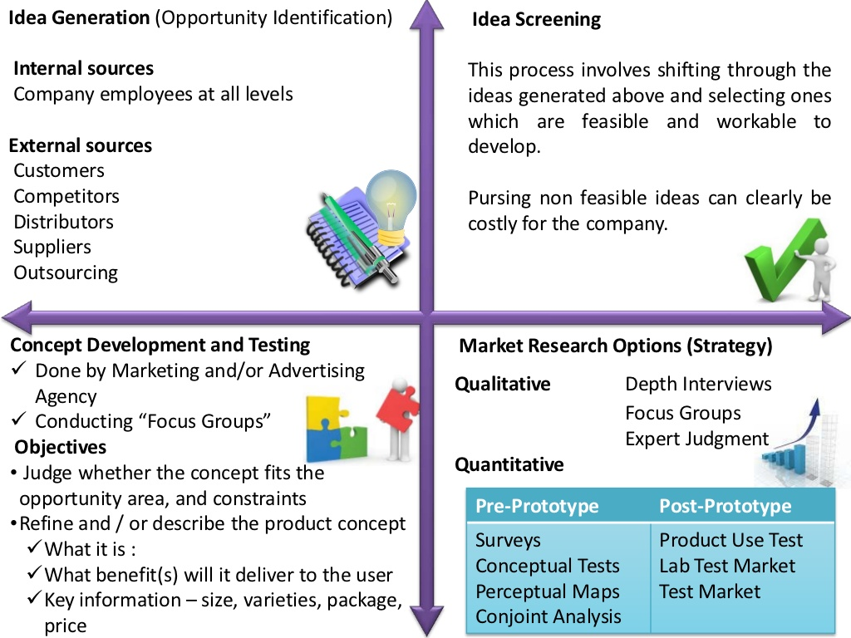
ETREPRENEURSHIP
Idea generation and Screening
Subject: Entrepreneurship Development & Intellectual Property Rights By : Alok Raj
30-Aug-25 Mohd Zaid AEO0771

Slide 27
Morphological Matrix
The Morphological Matrix is also referred to as ‘problem solving’. The method was developed in the 1960s by Fritz Zwicky, an astronomer from Switzerland.
It is a simple technique to quickly generate many different possibilities to answer a ‘how can we…’ question.
Step 1. Pick attributes
Describe the key attributes that play a role in your challenge. Write them down next to each other, horizontally.
Step 2. List possible components per attribute Make a list of possible components for each attribute and list these components beneath the attribute, thus creating columns.
Step 3. Combine components from each column, randomly Take one random component from every list and combine them to generate a new idea.
Subject: Entrepreneurship Development & Intellectual Property Rights By : Alok Raj
30-Aug-25 Mohd Zaid AEO0771

Slide 28
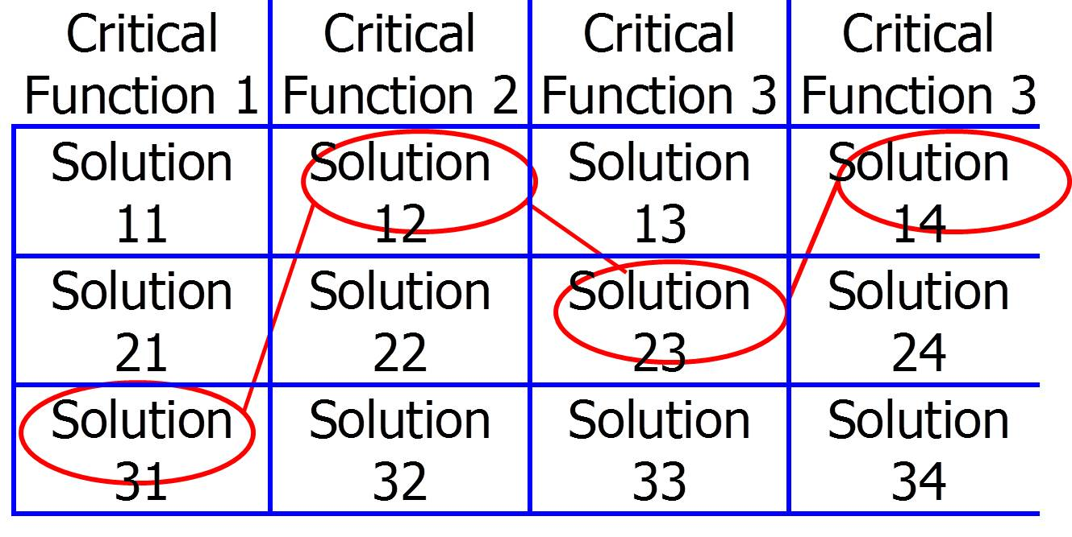
Morphological Matrix
Subject: Entrepreneurship Development & Intellectual Property Rights By : Alok Raj
30-Aug-25 Mohd Zaid AEO0771

Slide 29
Force field analysis
The technique is based on the assumption that any situation is the result of forces for and against the current state being in equilibrium. In order to promote change, either the driving forces should be strengthened or the resisting forces should be weakened.
Force field analysis does the following:
Presents the positives and negatives of a situation so they are easily comparable.
Considers all aspects of making the desired change.
Encourages agreement about the relative priority of factors on each side of the balance sheet.
Encourages honest reflection on the underlying roots of a problem and its solution.
Subject: Entrepreneurship Development & Intellectual Property Rights By : Alok Raj
30-Aug-25 Mohd Zaid AEO0771

Slide 30
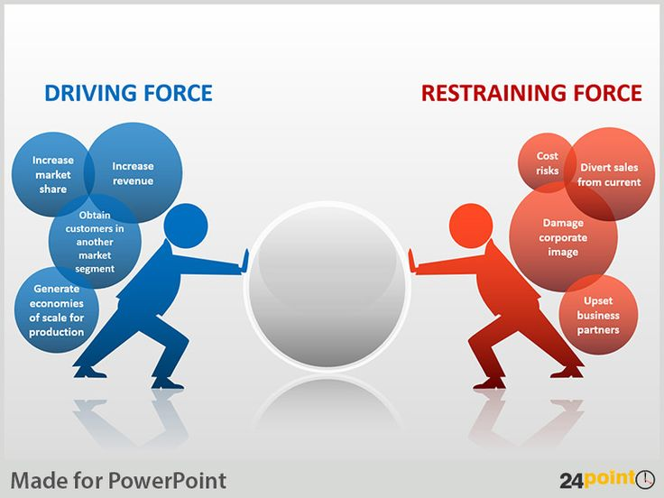
Force field analysis
Subject: Entrepreneurship Development & Intellectual Property Rights By : Alok Raj
30-Aug-25 Mohd ZaidI AEO0771

Slide 31
Daily Quiz
Enumerate the various means of generating ideas.
Highlight the steps in idea generation.
Define the force field analysis.
Give an example of morphological matrix.
Subject: Entrepreneurship Development & Intellectual Property Rights By : Alok Raj
30-Aug-25 Mohd Zaid AEO0771

Slide 32
Attribute listing
Attribute listing is a technique from the early 1930's which
takes an existing product or system,
breaks it into parts,
identifies various ways of achieving each part, and then
recombines these to identify new forms of the product or system.
Subject: Entrepreneurship Development & Intellectual Property Rights By : Alok Raj
30-Aug-25 Mohd zaid AEO0771

Slide 33
Attribute listing
Attributes can be classified into subcategories like
Physical attributes: shape, form, colour, texture, structure, sound, taste, door, space, density, location
Social attributes: responsibilities, taboos, power, ecological
Process attributes: selling, marketing, production, manufacturing, designing
Psychological attributes: needs, motivation, positive and negative emotions
Price attributes: production cost, consumer price, Consumer acquisition cost, manufacturing cost, sunk cost
Subject: Entrepreneurship Development & Intellectual Property Rights By : Alok Raj
30-Aug-25 Mohd Zaid AEO0771

Slide 34
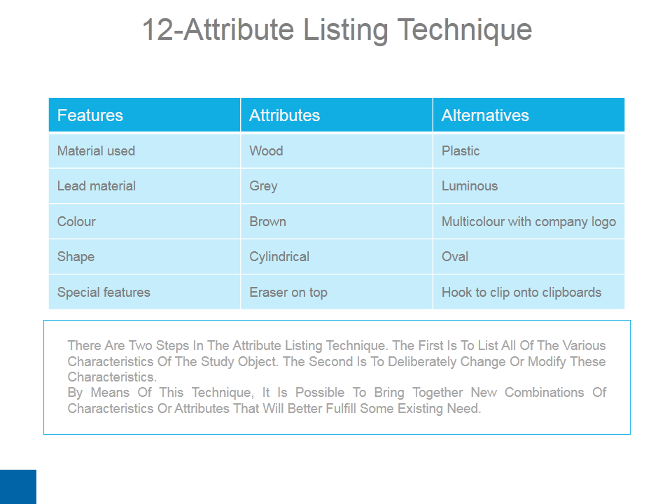
Attribute Listing
Subject: Entrepreneurship Development & Intellectual Property Rights By : Alok Raj
30-Aug-25 Mohd Zaid AEO0771

Slide 35
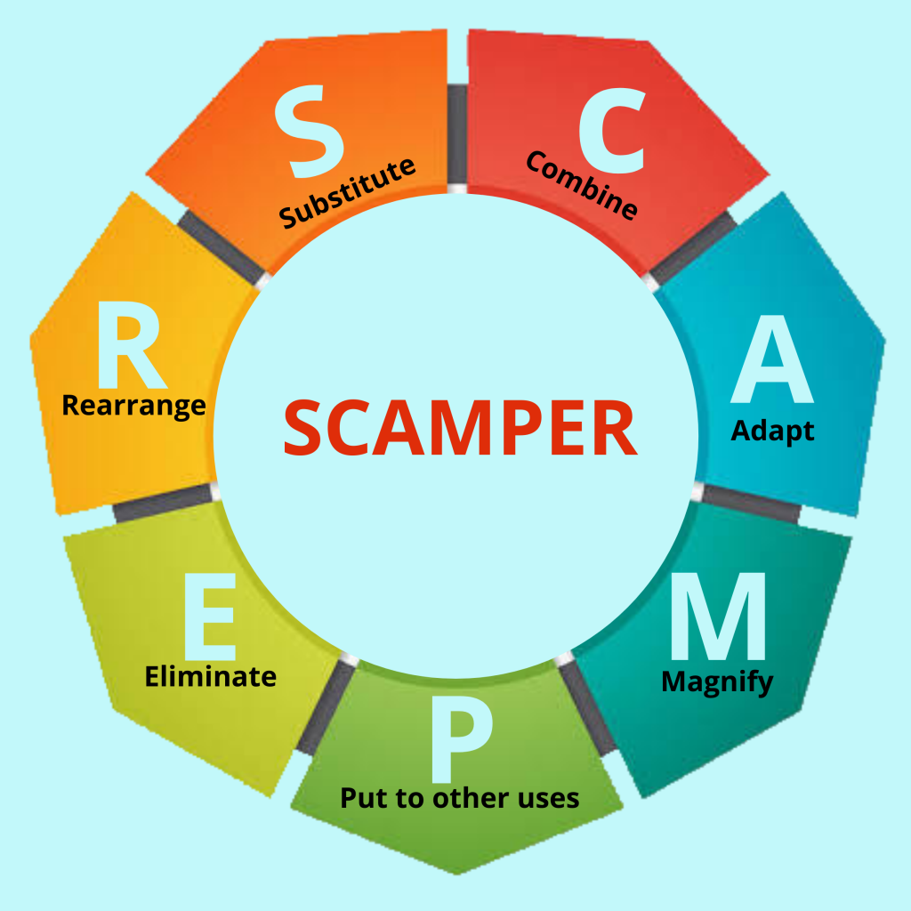
Scamper
Subject: Entrepreneurship Development & Intellectual Property Rights By : Alok Raj
30-Aug-25 Mohd Zaid AEO0771

Slide 36
SCAMPER
Substitute: The way the packaging of milk has evolved over the years.
What materials could be substituted to make the pen more eco-friendly, such as using recycled plastic or bamboo instead of traditional plastic? OR
What alternative types of algae or microorganisms can be substituted to enhance biofuel production, considering factors like growth rate and oil content?
Combine: Combining different ingredients to produce new flavors. can the pen be combined with another product or feature to make it more useful, like integrating a stylus tip for touchscreens?
Subject: Entrepreneurship Development & Intellectual Property Rights By : Alok Raj
30-Aug-25 Mohd Zaid AEO0771

Slide 37
SCAMPER
Adapt: How can a business adapt to changing marketing conditions, the COVID-19 pandemic, or the rise of e-commerce?
OR
How can we adapt the cultivation conditions (e.g., temperature, pH, nutrient supply) to make the algae more robust and productive.
Modify: If customers aren’t buying large quantities of a product, can selling them in sachets boost sales or can selling a product in large quantities satisfy customers looking to buy more of a product?
OR
Can modifications be made in making the process of compost fast ?
Subject: Entrepreneurship Development & Intellectual Property Rights By : Alok Raj
30-Aug-25 Mohd Zaid AEO0771
Notes:
https://studiousguy.com/entrepreneurship-and-entrepreneurial-traits/

Slide 38
SCAMPER
Put to another use: Can the biotech techniques used for algae be applied to other areas, such as wastewater treatment or pharmaceutical production, using algae as a platform?
Eliminate: Can eliminating a process be helpful in speeding up production and make work less hectic for workers?
Reverse: Can reversing the order of students sitting together in a class by placing the ones lagging in their grades at the front or with other students with better grades help improve their learning?
Subject: Entrepreneurship Development & Intellectual Property Rights By : Alok Raj
30-Aug-25 Mohd Zaid AEO0771

Slide 39
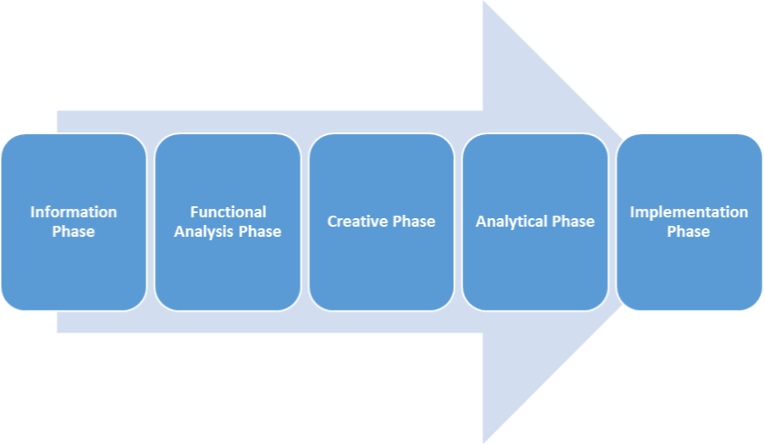
Value Analysis
Value Analysis is a method to achieve cost reduction by analyzing the utility or value of a product, service or process in relation to the cost incurred on it.
Subject: Entrepreneurship Development & Intellectual Property Rights By : Alok Raj
30-Aug-25 Mohd Zaid AEO0771
Notes:
https://barrazacarlos.com/what-is-entrepreneurial-culture/

Slide 40
Example Case
A bank is incurring extra cost at a particular branch. At the same time, it is getting complaints from customers about not adding a self-help desk. The value analysis team evaluated all the bank processes, such as banking services, technology maintenance, staff duties and roles, and relative costs.
It was discovered that the bank had employed two extra people than the required capacity and yet could not address customer problems due to confusion in roles. The team suggested introducing a help desk and employing the two extra employees at the desk to guide and help the customers. In a year, the branch’s profit grew by 30% at the same cost while receiving a positive response from its customers.
Subject: Entrepreneurship Development & Intellectual Property Rights By : Alok Raj
30-Aug-25 Mohd Zaid AEO0771

Slide 41
Alternative Scenario
Scenarios are qualitatively different descriptions of plausible futures which can give you a deeper understanding of potential environments in which you might have to operate and what you may need to do in the present.
Alternative Scenario analysis helps you:
to identify what environmental factors to monitor over time
Is a less risky, more conservative approach to planning than relying on standard business forecasts and trend analyses.
To take more innovative actions, and prevent undesirable outcomes. Scenarios can explore general alternative futures and specific problems or strategies.
Subject: Entrepreneurship Development & Intellectual Property Rights By : Alok Raj
30-Aug-25 Mohd Zaid AEO0771

Slide 42
Alternative Scenarios
Both Factors-Based and Growth-Based methods may be used in alternative scenario development.
To develop Alternative Factors Scenarios (AFS):
State the specific decision that needs to be made.
Identify the major environmental factors (forces, drivers, trends, limits, etc.) that impact on the decision.
Build the four scenarios.
With the scenarios in hand, identify business opportunities and risk management strategies within each scenario.
Examine the links and synergies of opportunities and risk abatement across the range of scenarios. This would help you to formulate more realistic and robust strategy.
Subject: Entrepreneurship Development & Intellectual Property Rights By : Alok Raj
30-Aug-25 Mohd Zaid AEO0771

Slide 43
Climate Change and Agriculture:
Scenario 1: Stable Climate - Predictable weather patterns, consistent crop yields.
Scenario 2: Extreme Weather Events - Frequent droughts, floods, and temperature fluctuations.
Scenario 3: Climate Mitigation - Successful global efforts to reduce greenhouse gas emissions, leading to more stable weather conditions.
Subject: Entrepreneurship Development & Intellectual Property Rights By : Alok Raj
30-Aug-25 Mohd Zaid AEO0771

Slide 44
Alternative Scenarios
To develop Alternative Growth Scenarios (AGS):
Jim Dator of the Hawaii Research Center for Futures Studies, proposed that all futures stories can be categorized into "Four Futures", or Generic Alternative Scenarios (GAS)[1]:
Continuation (usually "continued economic growth")
Collapse (from one or more of a variety of different reasons)
Disciplined Society (in which society in the future is seen as organized around some set of overarching values, ancient, traditional, natural, ideologically-correct, or God-given)
Transformational Society (usually either "high tech" or "high spirit," or both, with the end of some current patterns/values, and emergence of new ones, rather than the return to older traditional patterns/values)
Subject: Entrepreneurship Development & Intellectual Property Rights By : Alok Raj
30-Aug-25 Mohd Zaid AEO0771

Slide 45
Alternative Scenarios
Global Health Pandemic:
Scenario 1: Rapid Containment - Quick and effective containment measures, limited spread.
Scenario 2: Prolonged Pandemic - Continued waves of infection, slower recovery.
Scenario 3: Vaccine Breakthrough - Rapid development and distribution of effective vaccines
Subject: Entrepreneurship Development & Intellectual Property Rights By : Alok Raj
30-Aug-25 Mohd Zaid AEO0771

Slide 46
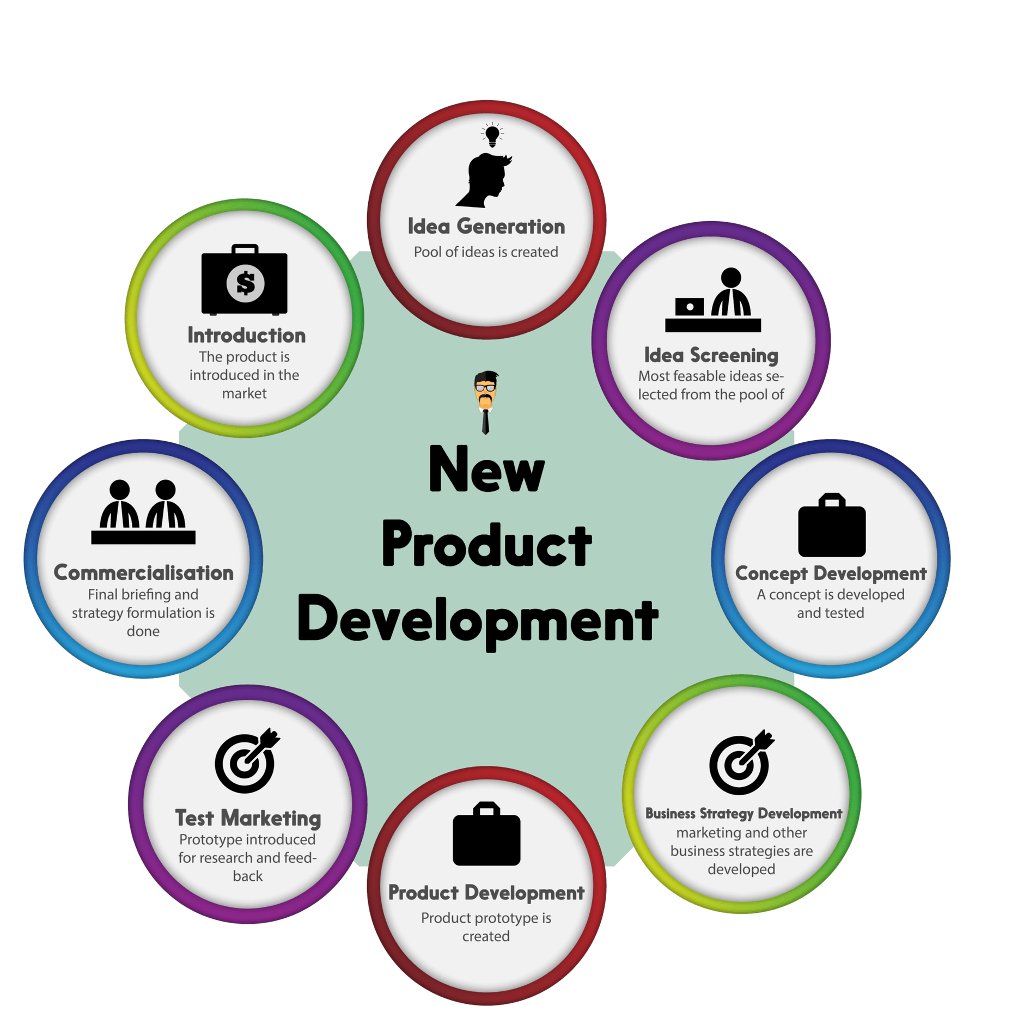
FABIAN ENTREPRENEURS
New Product Development
Subject: Entrepreneurship Development & Intellectual Property Rights By : Alok Raj
30-Aug-25 Mohd Zaid AEO0771

Slide 47
DRONE ENTREPRENEURS
Environmental Scanning and SWOT analysis
The process of collecting, evaluating, and delivering information for a strategic purpose is defined as environmental scanning.
Characteristics
Continuous Process
Exploratory Process
Dynamic Process
Holistic View
Subject: Entrepreneurship Development & Intellectual Property Rights By : Alok Raj
Mohd Zaid AOE0771

Slide 48
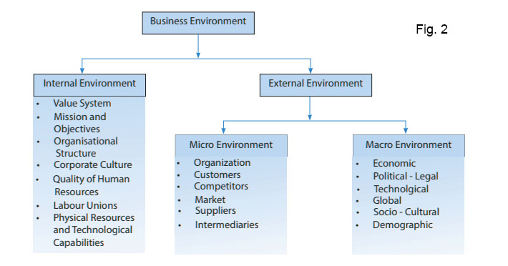
COLE’S CLASSIFICATION
Components of Environmental Scanning
Subject: Entrepreneurship Development & Intellectual Property Rights By : Alok Raj
Mohd Zaid AOE0771

Slide 49
Techniques of Environmental Scanning
SWOT Analysis- Strengths, Weaknesses, opportunities and threats analysis
PEST Analysis- Political, economic, social, and technological analysis
ETOP- Environmental Threat Opportunity Profile.
QUEST- Quick Environmental Scanning Technique with a focus on critical issues that have to be addressed in a short span.
Subject: Entrepreneurship Development & Intellectual Property Rights By : Alok Raj
Mohd Zaid AOE0771

Slide 50
Steps involved in Environment Analysis
Identifying
Scanning
Analyzing
Forecasting
Subject: Entrepreneurship Development & Intellectual Property Rights By : Alok Raj
Mohd Zaid AOE0771

Slide 51
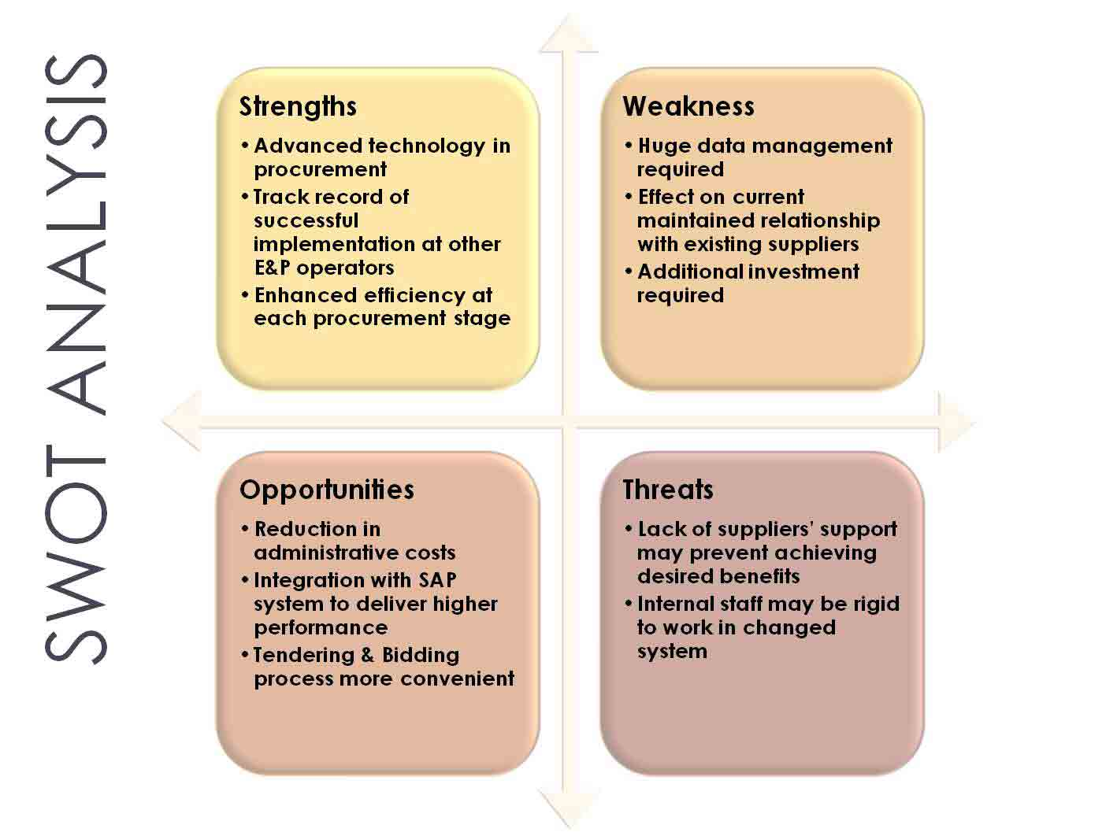
Environmental Scanning And SWOT Analysis
Subject: Entrepreneurship Development & Intellectual Property Rights By : Alok Raj
Mohd Zaid AOE0771

Slide 52
ON THE BASIS OF TYPE OF BUSINESS
Environmental Scanning
Importance of Environmental Scanning
Goal Accomplishment
Future Forecast
Market Knowledge
Focus on the Customer
Opportunities Identification
Subject: Entrepreneurship Development & Intellectual Property Rights By : Alok Raj
Mohd Zaid AOE0771

Slide 53
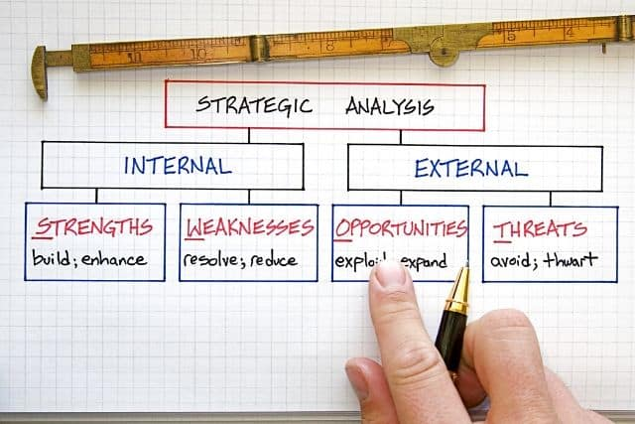
SWOT Analysis
Subject: Entrepreneurship Development & Intellectual Property Rights By : Alok Raj
Mohd Zaid AOE0771

Slide 54
ON THE BASIS OF USE OF TECHNOLOGY
Managing for Value Creation
Management skills for entrepreneurs play a vital role in creating and sustaining value within their businesses. Managing for value creation involves making strategic decisions and effectively utilizing resources to maximize the long-term worth of the company.
Strategic Planning
Market Analysis
Financial Analysis
Resource Allocation
Subject: Entrepreneurship Development & Intellectual Property Rights By : Alok Raj
Mohd Zaid AOE0771

Slide 55
Professional Entrepreneur
Innovation and Creativity
Customer-Centric Approach
Cost Management
Risk Management
Performance Measurement
Customer Relationship Management
Employee Development
Negotiation Skills
Subject: Entrepreneurship Development & Intellectual Property Rights By : Alok Raj
Mohd Zaid AOE0771

Slide 56
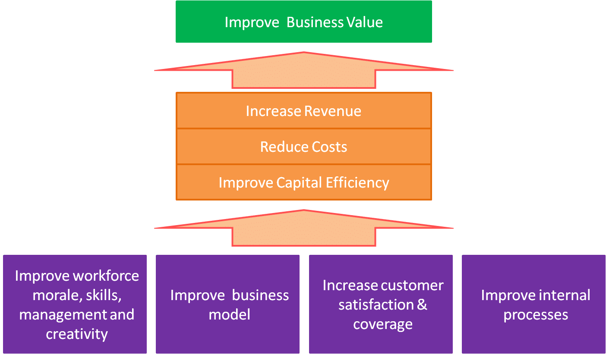
ON THE BASIS OF MOTIVATION
Managing for Value Creation
Subject: Entrepreneurship Development & Intellectual Property Rights By : Alok Raj
Mohd Zaid AOE0771

Slide 57
ON THE BASIS OF MOTIVATION
Sustaining Enterprise Model
A sustaining enterprise model, also known as a sustainable business model, is a framework that focuses on creating and maintaining a business that operates in an environmentally and socially responsible manner while also achieving financial profitability. Such models aim to balance economic, environmental, and social considerations to ensure long-term sustainability and success.
Subject: Entrepreneurship Development & Intellectual Property Rights By : Alok Raj
Mohd Zaid AOE0771

Slide 58
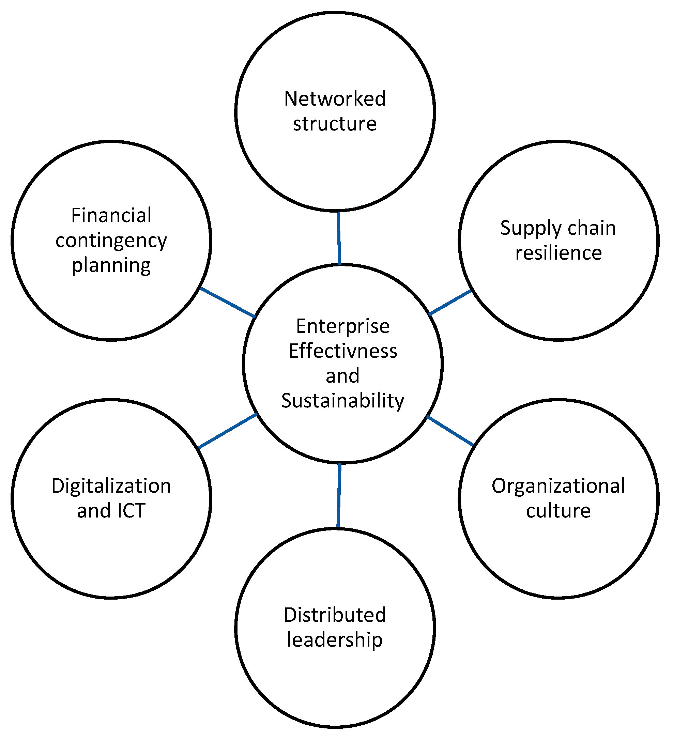
ON THE BASIS OF MOTIVATION
Sustaining Enterprise Model
Subject: Entrepreneurship Development & Intellectual Property Rights By : Alok Raj
Mohd Zaid AOE0771

Slide 59
ON THE BASIS OF ENTREPRENEURIAL ACTIVITY
Creating and Sustaining Enterprise Model
Triple Bottom Line (TBL) Approach: Sustaining enterprises often adopt the TBL framework, which considers three bottom lines: profit, planet, and people.
Social Responsibility: These enterprises are committed to social responsibility, which includes fair labor practices, ethical sourcing, community engagement, and initiatives that benefit society.
Supply Chain Sustainability: Sustaining enterprises assess and improve the sustainability of their supply chains.
Subject: Entrepreneurship Development & Intellectual Property Rights By : Alok Raj
Mohd Zaid AOE0771

Slide 60
Creating and Sustaining Enterprise Model
Employee Engagement: Sustaining enterprises often engage their employees in sustainability efforts. They may provide training, promote eco-conscious behaviors, and involve staff in decision-making related to sustainability.
Economic Viability: Sustainability does not come at the expense of profitability. Sustaining enterprises seek to generate a healthy financial return to ensure their long-term viability.
Subject: Entrepreneurship Development & Intellectual Property Rights By : Alok Raj
Mohd Zaid AOE0771

Slide 61
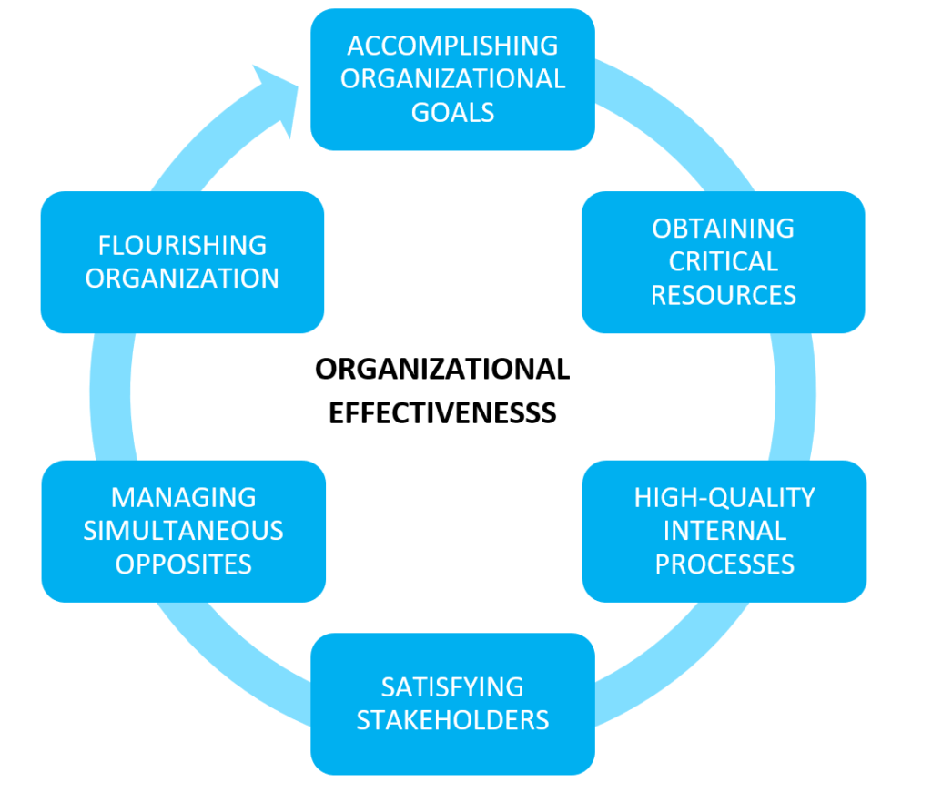
Organizational Effectiveness
Organizational effectiveness refers to the extent to which an organization is able to achieve its goals and objectives while utilizing its resources efficiently.
Subject: Entrepreneurship Development & Intellectual Property Rights By : Alok Raj
Mohd Zaid AOE0771

Slide 62
Key factors and strategies that contribute to organizational effectiveness
Clear Mission and Goals
Strategic Planning
Effective Leadership
Resource Allocation
Talent Management
Effective Communication
Subject: Entrepreneurship Development & Intellectual Property Rights By : Alok Raj
Mohd Zaid AOE0771

Slide 63
Adaptability and Innovation
Ethical and Legal Compliance
Technology Adoption
Feedback and Continuous Improvement
Sustainability
Collaboration and Teamwork
Subject: Entrepreneurship Development & Intellectual Property Rights By : Alok Raj
Mohd Zaid AOE0771

Slide 64
New initiatives taken by the Government to promote entrepreneurship in India at a larger scale
Startup India: The Startup India initiative, launched in 2016, aims to foster a culture of innovation and entrepreneurship. It provides various benefits to startups, including tax exemptions, easier compliance, and access to funding. The initiative also includes programs like Startup India Seed Fund Scheme and Pradhan Mantri Mudra Yojana.
Standup India: This initiative, launched in 2016, encourages entrepreneurship among women and individuals from marginalized communities by providing bank loans between ₹10 lakhs and ₹1 crore for starting new enterprises.
Atal Innovation Mission (AIM): AIM, launched in 2016, focuses on promoting innovation and entrepreneurship among students and young entrepreneurs. It includes initiatives such as Atal Tinkering Labs in schools, Atal Incubation Centres, and Atal New India Challenges.
Subject: Entrepreneurship Development & Intellectual Property Rights By : Alok Raj
Mohd Zaid AOE0771 Unit 1

Slide 65
Make in India: The Make in India campaign encourages entrepreneurship in the manufacturing sector by simplifying regulations, improving infrastructure, and attracting foreign investment. It aims to make India a global manufacturing hub.
Digital India: The Digital India program promotes entrepreneurship in the technology and digital sectors by expanding internet connectivity, fostering innovation, and supporting the growth of digital start ups.
Fund of Funds for Start ups (FFS): This initiative, part of the Start up India program, provides financial support to start ups by investing in SEBI-registered venture capital funds. The goal is to encourage more funding for early-stage start ups.
Subject: Entrepreneurship Development & Intellectual Property Rights By : Alok Raj
Mohd Zaid AOE0771

Slide 66
Innovation and Research Parks: The government has set up innovation and research parks and incubation centers across the country to provide startups with infrastructure, mentorship, and access to resources.
Ease of Doing Business: Ongoing efforts to improve the ease of doing business in India, including simplifying regulations and reducing bureaucratic hurdles, benefit entrepreneurs and start ups.
Tax Benefits: The government offers various tax incentives and exemptions for start ups to promote investment and growth.
Subject: Entrepreneurship Development & Intellectual Property Rights By : Alok Raj
Mohd Zaid AOE0771

Slide 67
International Collaboration: The government has been actively engaging in international collaborations and partnerships to foster entrepreneurship and innovation. Initiatives like the India-UK Tech Partnership and India-Israel Innovation Bridge promote cross-border collaboration.
Skill Development: Initiatives like the National Skill Development Mission aim to enhance the skill set of the Indian workforce, making them more employable and entrepreneurial.
Government Procurement: The government has simplified procurement processes for startups, allowing them to participate in government tenders more easily.
Vishwakarma Scheme for traditional workers – Rs. 13000 cr
Subject: Entrepreneurship Development & Intellectual Property Rights By : Alok Raj
Mohd Zaid AOE0771

Slide 68
Assignment
Generate an idea for a product or service. Produce a reflective account of how you generated and refined your idea.
You should include:
The conclusions you have drawn from environmental scanning to identify the business opportunity.
Include how your business idea was developed and why you rejected other ideas.
The theories and methods of idea generation and creativity you have used to refine your idea.
Subject: Entrepreneurship Development & Intellectual Property Rights By : Alok Raj
Mohd Zaid AOE0771

Slide 69
Topic links
https://www.youtube.com/watch?v=yuWNXcdxxVY
https://www.youtube.com/watch?time_continue=42&v=JDkOngxPTQ4&feature=emb_logo
https://www.youtube.com/watch?time_continue=7&v=ntuS4dLIf5s&feature=emb_logo
Subject: Entrepreneurship Development & Intellectual Property Rights By : Alok Raj
Mohd Zaid AOE0771

Slide 70
MCQ
1. Which one of the following is the next stage to the Concept Stage of Product Planning and Development Process:
Idea Stage
Product Planning Stage
Product Development Stage
Test Marketing Stage
2. Idea of new product is tested in potential consumers to determine consumer acceptance at _________ stage.
Concept.
Product development.
Test marketing.
Commercialization.
3. Value analysis is normally applied to
New products
Old products
Future products
Both (A) and (B)
Subject: Entrepreneurship Development & Intellectual Property Rights By : Alok Raj
Mohd Zaid AOE0771

Slide 71
4. Value analysis is a ____ process
Remedial
Preventive
Continuous
None of the above
5. What does c stand for in SCAMPER?
Combine
Christmas
Can
Class
6. Attribute listing is...
a. Takes the place of another product
b. Solving problems through an indirect or creative approach
c. List the product’s characteristics that make it unique from other goods then find ways to improve those attributes
d. List a products characteristics then combine some or all of those to create a new product
Mohd Zaid AOE0771
Subject: Entrepreneurship Development & Intellectual Property Rights By : Alok Raj

Slide 72
7. Forced Analogies means:
a. Similarity of like features of two things
b. Using metaphors and similes to create connections where none exist
c. Focuses on an attribute or an object in order to determine how the attribute can be improved.
d. List a product’s characteristics then combine some or all of those to create a new product
8. Brainstorming is…
a. Creative-thinking technique involving the identification of as many different ideas as possible during a certain time frame.
b. Teams responding to teammates ideas in a certain order
c. Mental connection or relation between thoughts, feelings, ideas or sensations.
d. State the first thing that comes to mind when hearing (or seeing, feeling, smelling or tasting) anything another team member provides
Subject: Entrepreneurship Development & Intellectual Property Rights By : Alok Raj
Mohd Zaid AOE0771

Slide 73
MCQ
9. Free Association means to…
a. Creative-thinking technique involving the identification of as many different ideas as possible during a certain time frame.
b. Teams responding to teammates ideas in a certain order
c. Mental connection or relation between thoughts, feelings, ideas or sensations.
d. State the first thing that comes to mind when hearing (or seeing, feeling, smelling or tasting) anything another team member provides
10. Morphological analysis is...
a. Takes the place of another product
b. Solving problems through an indirect or creative approach
c. List the product’s characteristics that make it unique from other goods then find ways to improve those attributes
d. List a products characteristics then combine some or all of those to create a new product
VIJAYLAXMI AOE0771 Unit 1
Subject: Entrepreneurship Development & Intellectual Property Rights By : Alok Raj

Slide 74
Old Question Papers
https://aktu.ac.in/pdf/old-papers/dec-2013/PDF's/EOE071.pdf
http://www.aktuonline.com/papers/mba-4-sem-entrepreneurship-development-rmb-402-2017-18.pdf
https://www.uptunotes.com/aktu-uptu-entrepreneurship-development-mam401a-previous-year-question-paper/
https://abesit.in/library/download/MBA/Sem.3/2016-17/ENTREPRENEURSHIP-DEVELOPMENT-NMBA-031MBTM-031.pdf
Subject: Entrepreneurship Development & Intellectual Property Rights By : Alok Raj
Mohd Zaid AOE0771

Slide 75
Expected Questions
Explain the concept of generating ideas.
Discuss the different techniques of generating new ideas.
Discuss the process of generating ideas for a new business.
Define the morphological analysis technique of idea generation with the help of suitable example.
Give an example of how SCAMPER technique is used for generating new ideas.
Brainstorming is a technique of generating a pool of ideas. Discuss.
How does value analysis help in generating ideas which can bring maximum profitability in the future. Explain with the help of an example.
Discuss the new product development process in detail taking an example.
Discuss factor based and growth based alternative scenarios.
Define environmental scanning. What is the need for environment scanning?
Discuss the various techniques for environment scanning in detail.
Subject: Entrepreneurship Development & Intellectual Property Rights By : Alok Raj
Mohd Zaid AOE0771

Slide 76
Recap
Ideas are the building blocks for all innovation. The first step of starting with anything new is finding that idea.
We must make use of the different tools and techniques available to us to come up with quality ideas. The various techniques of iteration for ideas are Matrix and Morphological Analysis, Force Field Analysis, Attribute Listing, Scamper, Alternative Scenarios, Forced Association, Value Analysis. To conceptualise the idea into a product, it is important to analyse the business environment. For this SWOT Analysis can be done or other techniques for environmental scanning can be used.
Once the feasibility of the idea is checked, the new product development process moves the idea conceptualisation to the final stage of commercialisation.
Subject: Entrepreneurship Development & Intellectual Property Rights By : Alok Raj
Mohd Zaid AOE0771

Slide 77
Reference
1. Roy :Entrepreneurship, OUP
2. Entrepreneurship 10th Ed (Indian Edition) 2016 by Robert Hisrich Michael Peters Dean Shepherd, McGraw Hill
3. Khanka, S.S.; Entrepreneurial Development; S. Chand and Co.
4. Kumar, Arya; Entrepreneurship; Pearson Education.
5.Desai, Vasant; Dynamics of Entrepreneurial Development and Management; Himalaya Publishing
6. Blundel, R. and Lockett, N.; Exploring Entrepreneurship Practices and Perspectives; Oxford Publications.
7. Dollinger, M. J.; Entrepreneurship: New Venture Creation; PHI Learning.
Subject: Entrepreneurship Development & Intellectual Property Rights By : Alok Raj
Mohd Zaid AOE0771

Slide 78
Thank You
Subject: Entrepreneurship Development & Intellectual Property Rights By : Alok Raj
Mohd Zaid AOE0771

